Slide 1
Text Summarizer
Project-II:

Slide 2
Text summarizer:
Objective:
THIS PROJECT BUILDS A TEXT SUMMARIZER THAT CONDENSES LENGTHY DOCUMENTS INTO SHORTER VERSIONS CAPTURING THE KEY IDEAS. IT HELPS PEOPLE QUICKLY GRASP INFORMATION FROM ARTICLES, EMAILS, OR RESEARCH PAPERS, SAVING TIME AND IMPROVING KNOWLEDGE RETENTION.

Slide 3
Text summarizer:
Process:
1.Load Text and Preprocess:
Load the text to be summarized.
Define stop words using nltk.corpus.stopwords.
2.Create Frequency Table:
Generate a frequency table of significant words in the text.
3.Score Sentences:
Tokenize the text into sentences and score each sentence based on word frequencies.

Slide 4
Text summarizer:
Process:
4.Calculate Average Score:
Calculate the average sentence score to determine the threshold for selecting sentences.
5.Generate Summary:
Generate the summary by selecting sentences that have a score above the threshold.

Slide 5
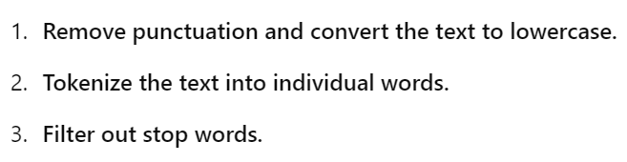
Text summarizer:
1.Load Text and Preprocess:
Remove the stop words :
(A , an , the , and , but , or, nor, so, yet , in, on, at, by, for, with, about, against, between, into, through, during, before, after, above, below, to, from, up, down, under, again, further, then, once,………..)

Slide 6
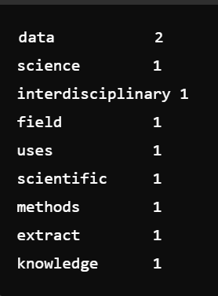
Text summarizer:
2.Create Frequency Table:
Example:
"Data science is an interdisciplinary field that uses scientific methods to extract knowledge from data.“

Slide 7
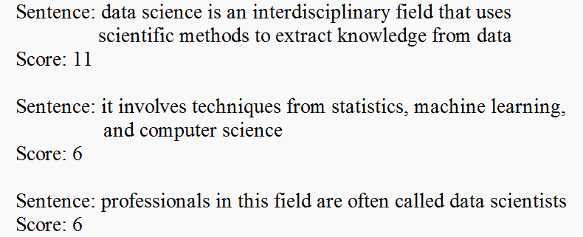
Text summarizer:
3.Score Sentences:
Ex:
"Data science is an interdisciplinary field that uses scientific methods to extract knowledge from data. It involves techniques from statistics, machine learning, and computer science. Professionals in this field are often called data scientists.“

Slide 8
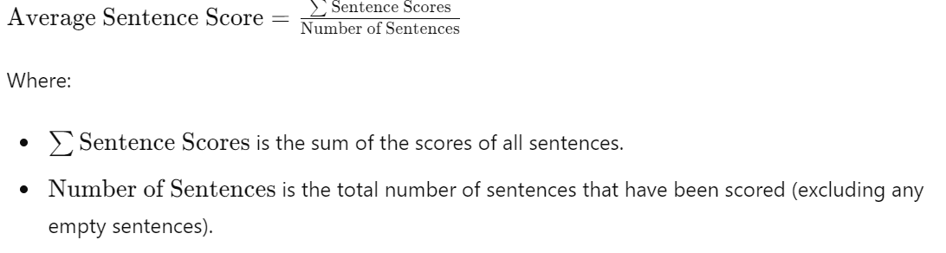
Text summarizer:
4.Calculate Average Score:

Slide 9
Text summarizer:
5.Generate Summary:
SentenceScore > Avg score
Include sentences that have a score above a certain threshold.
Select the sentences based on their scores.

